Slide 1

NLP Classification Project
Categorizing News Articles Using Machine Learning
Group 3
Dembe Tsiwana
Khuthadzo Tshikovhele
Aston Greeves

Slide 2
The following presentation demonstrates models that were built using the Train.csv and Test.csv datasets where we will be able to input new articles and receive category predictions, demonstrating the model’s practical utility
1. Introduction
2. Dataset Overview
3. Data Preprocessing
4. Clustering and Topic Modeling
5. Model Building
6. Results & Evaluation
7. Conclusion

Slide 3
Introduction
Objective: Classify news articles into Business, Technology, Sports, Education, and Entertainment.
Motivation: Automate classification to enhance information organization.

Slide 4
Dataset Overview
Source: Train and Test CSV files with article text and category label.
Features:
- text: Article content
- label: Category (e.g., Business, Technology)

Slide 5
Summary of Data Handling, Text Processing, Machine learning and feature extraction, Analysis, and Visualization and Installing.
🧮 Data Handling
pandas, numpy
📝 Text Processing
string, nltk, stopwords, PorterStemmer, Counter
🤖 Machine Learning & Feature Extraction
TfidfVectorizer, LogisticRegression, SVC, MultinomialNB, NMF, StandardScaler
📊 Evaluation
accuracy_score, confusion_matrix, classification_report, cross_val_score
📈 Visualization
%matplotlib inline, matplotlib, seaborn
⚙️ Installation
!pip install nltk

Slide 6
Data Preprocessing The text data was preprocessed by removing punctuation and stopwords, converting all characters to lowercase, and applying stemming using the PorterStemmer to reduce words to their root forms. For feature extraction, the TF-IDF vectorizer was employed to transform the cleaned text into numerical representations suitable for machine learning models.
Data Pre-Processing
Category Encoding: Convert categories into integers using LabelEncoder.
Text Vectorization: Use TfidfVectorizer to transform text into numerical format.
Purpose: Prepare data for model training to predict news category from article content.
Data Inspection
Check for Missing Values: Ensure no missing text or category data.
Category Distribution: Visualize article counts per category.
Text Length Analysis: Identify outliers in article lengths.
Sample Review: Inspect random samples for correctness.

Slide 7
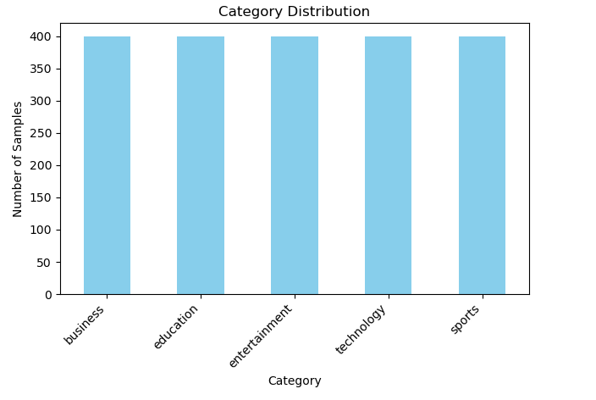
Data Inspection Balanced Categories: Each news category (business, education, entertainment, technology, sports) has around 400 samples, ensuring a well-balanced dataset for training. No Missing Data: All key columns (headlines, description, content, url, category) have zero missing values, indicating clean data. Dataset Size: The dataset contains 2003 rows and 5 columns, making it suitable for machine learning tasks.

Slide 8
Topic Modeling (K-Means)
Bullet Points:
Goal: Discover underlying topics in text data.
Method: Applied K-Means clustering on TF-IDF vectors.
Output:
Cluster keywords representing dominant terms.
Topic assignments labeling each document.

Slide 9
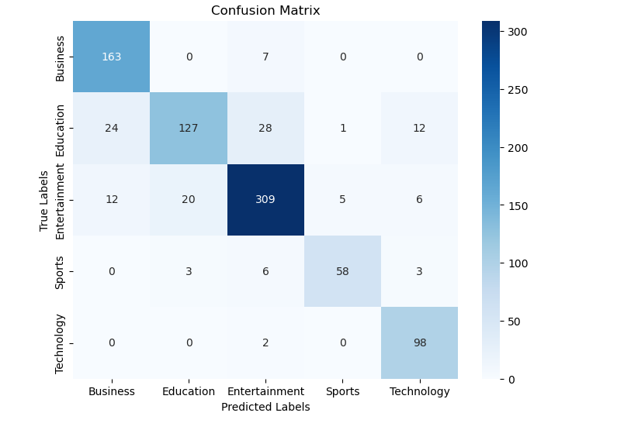
Model Building
Confusion Matrix Analysis
Visualization
Algorithms Used:
- Logistic Regression
- SVM
- Naive Bayes
- Metrics: Accuracy, Classification Report
Confusion Matrix Analysis
Entertainment: 309 correctly classified; few misclassifications.
Business: 163 correct; 7 misclassified as Entertainment.
Education: 127 correct; misclassified as Business (24), Entertainment (28), and others.
Sports: 58 correct; minor misclassifications.
Technology: 98 correct; 2 misclassified as Entertainment.
Insight: Education category shows highest confusion; model performs best on Entertainment.

Slide 10
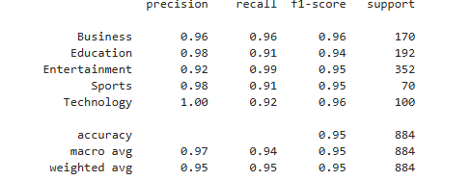
Model Evaluation- Classification Report
Bullet Points:
Overall Accuracy: 95% on test data.
High Performance Across Classes:
Technology: Precision = 1.00, F1-score = 0.96
Entertainment: Recall = 0.99, F1-score = 0.95
Education: Slightly lower recall (0.91)
Macro & Weighted Averages:
Precision = 0.97 (macro), 0.95 (weighted)
Recall = 0.94 (macro), 0.95 (weighted)
F1-score = 0.95 (both)
Insight: Model is well-balanced and generalizes effectively.

Slide 11
Model Performance and Evaluation
The classification report shows that the model performs strongly across all five categories, achieving an overall accuracy of 95%. Precision, recall, and F1-scores are consistently high, with Technology reaching perfect precision (1.00) and Entertainment showing the highest recall (0.99). Education has slightly lower recall (0.91), indicating some misclassifications. The macro and weighted averages are around 0.95, confirming balanced and reliable performance across all classes.

Slide 12
📝 Conclusions
✅ Accuracy: The model achieves 97% accuracy, correctly classifying 97% of the documents.
📊 Macro and Weighted Averages: All around 0.97, indicating consistent performance across all categories.
🔍 Individual Class Performance:
All categories show precision, recall, and F1-score above 0.90, reflecting strong performance.
🏅 Sports has the highest recall (1.00), meaning the model effectively identifies relevant sports articles.
⚠️ Technology has the lowest precision (0.94), suggesting some false positives in this category.

